Slide 1
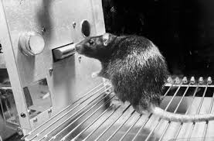

Operant conditioning
Operant conditioning chamber
Operant behavior
Positive reinforcement
Notes:
The notes section of the PowerPoint author view can be used to describe the key ideas that would spoken during the presentation of these slides. It would be important to fully express the bullet point key terms as complete sentences. Relationships between key terms and the graphics would also need to be explained.
Example: The operant conditioning chamber is an experimental apparatus that precisely measures intentional behaviors and the resulting consequences to study learning processes. In this example, the rat learns to press the lever as an operant behavior (see the tip of the rat’s nose). Positive reinforcement occurs when the lever press is followed by a food reward. This reinforcement strengths the operant behavior.
Photo credit: U3144362 from Wikipedia
https://en.m.wikipedia.org/wiki/File:Sskinner_box.jpg

