Slide 1
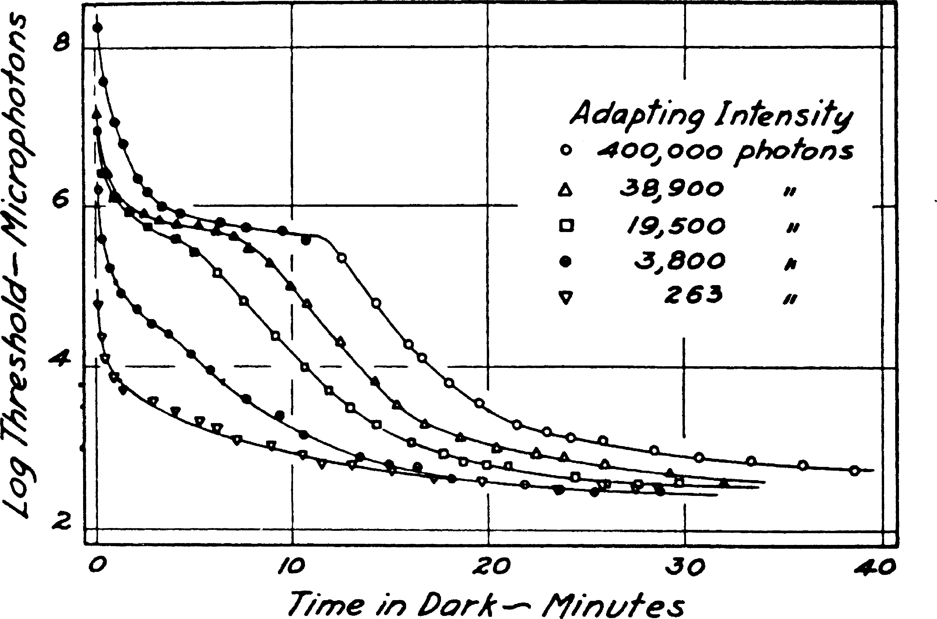
Rods plus Cones
Rod/Cone break
Rods only
Lowest threshold –
Maximum sensitivity
Notes:
The original graph is from Hecht, Haig, and Chase (1937). This was reproduced in Reuter (2011).
https://www.sciencedirect.com/science/article/pii/S0042698911003105#f0005

